Slide 1
CLASSIFYING GALAXIES
Group 1 Benny - Rongyan Zhu
Charles - Chao Gao
Gelman - Haoxuan Xie
Peter - Jiayao Wang
Org - Qixuan Huang

Slide 2
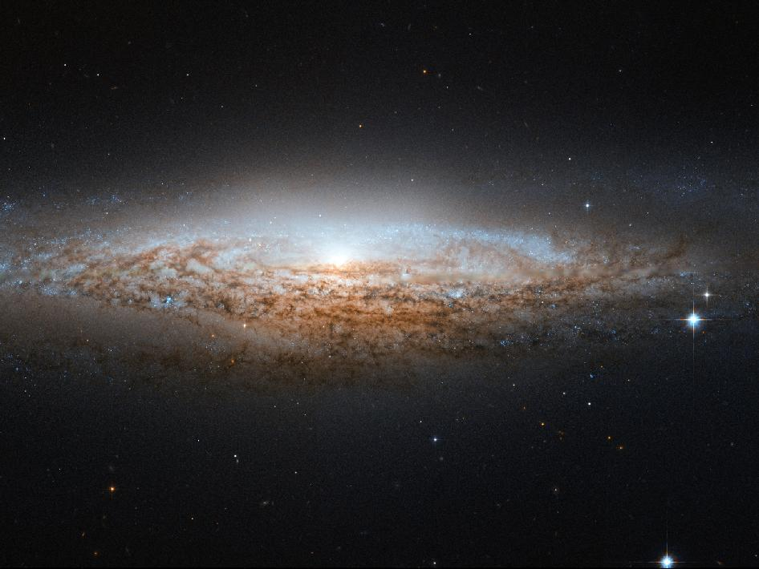
problem descriptions
galaxy images analysis
determine probability distributions by neural network
approaches
data preprocessing
CNN model
data prediction
algorithms
CNN model
convolutional, pooling, dense layers
batch normalization
relu/softmax activation, Adam optimizer
training
epochs of 50, batch size of 16
INTRODUCTION

Slide 3
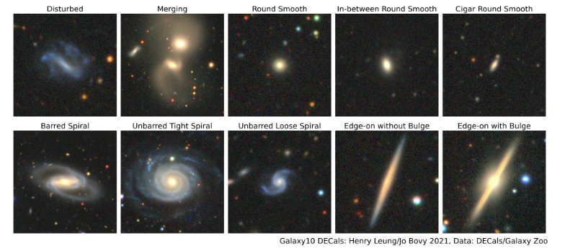
Dataset
name: Galaxy10 DECals
size: 17736
image: 256×256 pixels colored galaxy
classes: 10
we use: images and ans from columns in Galaxy10_DECals.h5
image source: DESI Legacy Imaging Survey
label source: Galaxy Zoo
METHODOLOGY
1/2

Slide 4
Code Description
data preprocessing
loading
train_test_split,
data generator
building CNN model
- sequential()
- convolutional layers
- fully connected layers
model training
model evaluation
- test predict
- ROC
- confusion matrix
METHODOLOGY
2/2

Slide 5
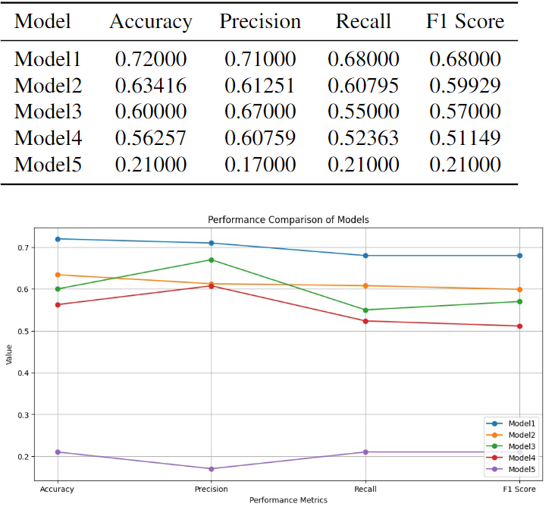
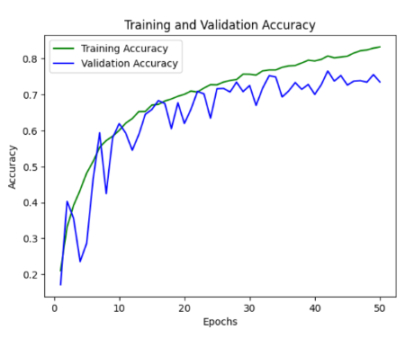
Comparative Performance: Model 1 Leads Across Metrics
Model's Training vs. Validation Accuracy over Epochs
RESULTS

Slide 6
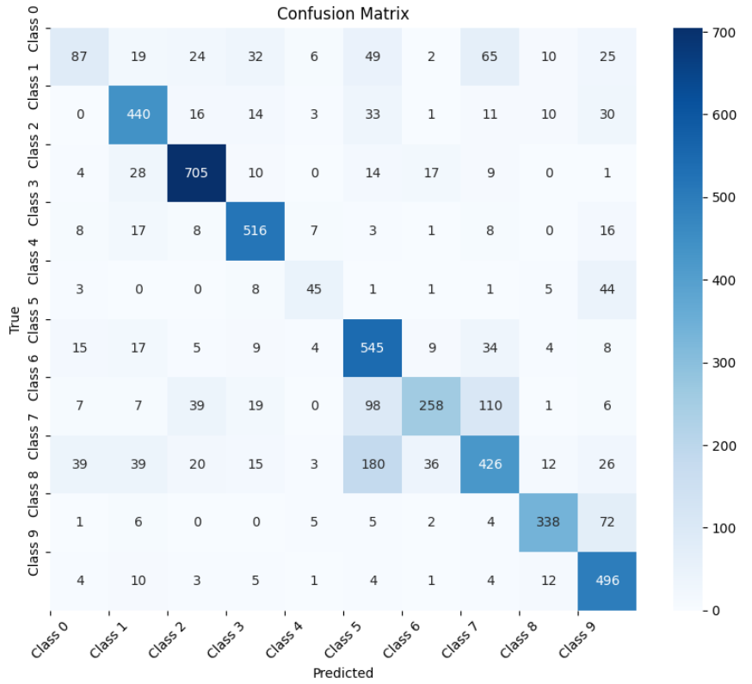
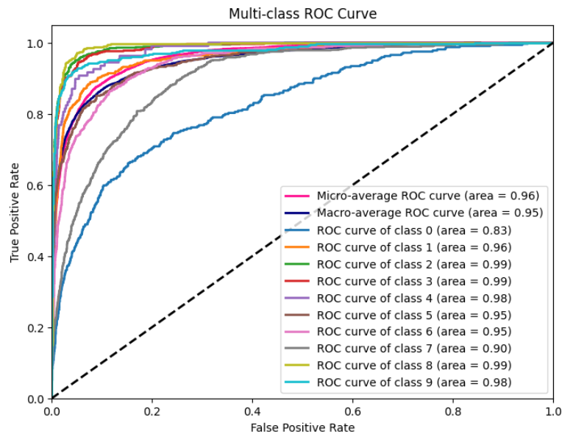
Multi-class ROC Curve: High AUC Values Across Classes
Confusion Matrix: True Predictions vs Misclassifications
RESULTS

Slide 7
design and optimize the model to enhance classification efficiency
further explore deep learning techniques and strategies
evaluate and compare everyone’s model
deepening our understanding of CNN
CONCLUSIONS
1/2

Slide 8
Future Work
avoid overfitting
improve test data accuracy
avoid high memory usage
CONCLUSIONS
2/2

Slide 9
Taylor, D. (October 13, 2023). 10 Ways Space Exploration Benefits Earth [Part I]. Retrieved from https://dylantaylor.org/10-ways-space-exploration-benefits-earth-part-i/
astroNN. (October 13, 2023). [Examples images of each class from Galaxy10 DECals [Graph]]. Galaxy10 DECals Dataset. Retrieved from https://astronn.readthedocs.io/en/latest/_images/galaxy10_example.png
REFERENCES

Slide 10

THANK YOU

